Slide 1


Data Mining and Data Warehousing CSE-4107
Md. Manowarul Islam
Associate Professor, Dept. of CSE
Jagannath University

Slide 2
Contents
Cluster Analysis
Application of Clustering
Major clustering approach
Clustering Algorithm
K-means Algorithm
Nearest Neighbor Algorithm
Agglomerative Algorithm
Divisive Algorithm
Conclusion
References

Slide 3
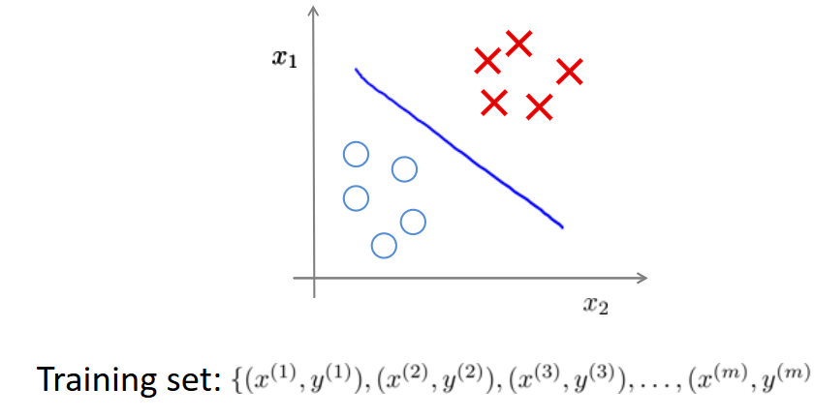
Supervised learning vs. unsupervised learning
Supervised learning: discover patterns in the data that relate data attributes with a target (class) attribute.
These patterns are then utilized to predict the values of the target attribute in future data instances.

Slide 4
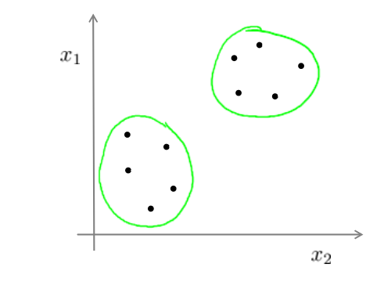
Supervised learning vs. unsupervised learning
Unsupervised learning: The data have no target attribute.
We want to explore the data to find some intrinsic structures in them.

Slide 5
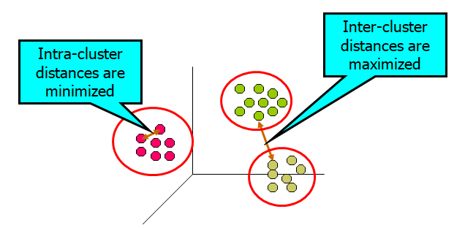
What is Cluster Analysis?
Cluster: A collection of data objects
similar (or related) to one another within the same group
dissimilar (or unrelated) to the objects in other groups
Cluster analysis (or clustering, data segmentation, …)
Finding similarities between data according to the characteristics found in the data and grouping similar data objects into clusters

Slide 6
Cluster Analysis
Unsupervised learning: no predefined classes (i.e., learning by observations vs. learning by examples: supervised)
Clustering is often called an unsupervised learning task as no class values denoting an a priori grouping of the data instances are given, which is the case in supervised learning.
Due to historical reasons, clustering is often considered synonymous with unsupervised learning.

Slide 7
What is clustering for?
Let us see some real-life examples
Example 1: groups people of similar sizes together to make “small”, “medium” and “large” T-Shirts.
Tailor-made for each person: too expensive
One-size-fits-all: does not fit all.

Slide 8
What is clustering for?
Illustrative Example 2: are they in the same cluster?
Lizard, sparrow,viper, seagull,
gold fish, frog
Two clusters
Clustering criterion: How animals bear their progeny
Blue shark,
sheep, cat,
dog
Gold fish, red mullet, blue shark
Sheep, sparrow, dog, cat, seagull, lizard, frog, viper
Two clusters
Clustering criterion: Existence of lungs

Slide 9
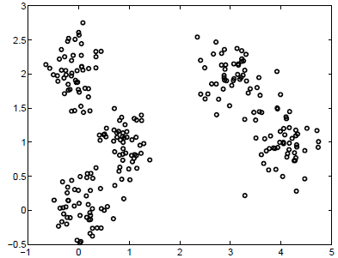
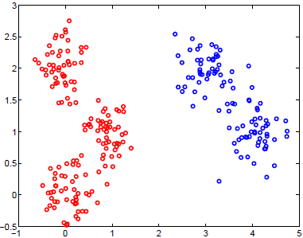
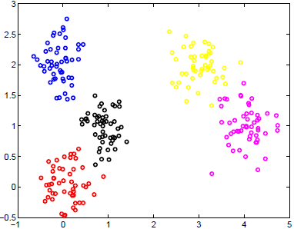
What is clustering for?
Illustrative Example 1: how many clusters?

Slide 10
What Is Good Clustering?
A good clustering method will produce high quality clusters with
high intra-class similarity
low inter-class similarity
The quality of a clustering result depends on both the similarity measure used by the method and its implementation.
The quality of a clustering method is also measured by its ability to discover some or all of the hidden patterns.

Slide 11
Applications
Biology: taxonomy of living things: kingdom, phylum, class, order, family, genus and species
Information retrieval: document clustering, Google search, topic-based news
Land use: Identification of areas of similar land use in an earth observation database
Marketing: Help marketers discover distinct groups in their customer bases, and then use this knowledge to develop targeted marketing programs

Slide 12
Applications
City-planning: Identifying groups of houses according to their house type, value, and geographical location
Earth-quake studies: Observed earth quake epicenters should be clustered along continent faults
Climate: understanding earth climate, find patterns of atmospheric and ocean

Slide 13
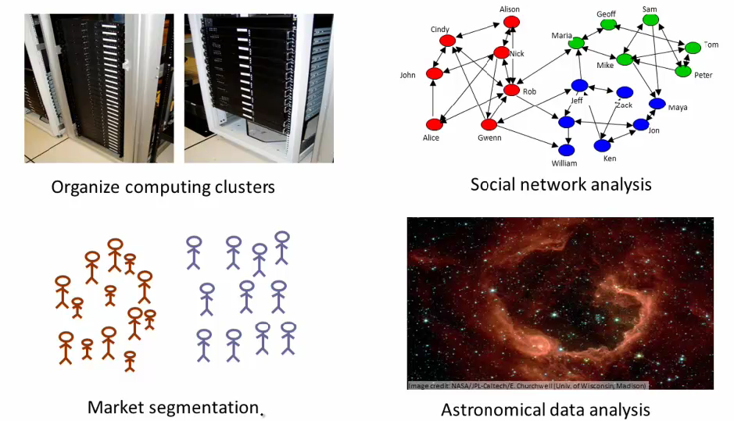
Applications
Real Applications: Emerging Applications
Notes:
Server clustering
Grouping customers based on their favours
Social networks: discover close-knit cluster
Use galaxy cluster to study universal mass

Slide 14
Considerations for Cluster Analysis
Partitioning criteria
Single level vs. hierarchical partitioning (often, multi-level hierarchical partitioning is desirable)
Separation of clusters
Exclusive (e.g., one customer belongs to only one region) vs. non-exclusive (e.g., one document may belong to more than one class)
Similarity measure
Distance-based (e.g., Euclidian, road network, vector) vs. connectivity-based (e.g., density or contiguity)

Slide 15
Requirements and Challenges
Scalability
Clustering all the data instead of only on samples
Ability to deal with different types of attributes
Numerical, binary, categorical, ordinal, linked, and mixture of these
Constraint-based clustering
User may give inputs on constraints
Use domain knowledge to determine input parameters
Others
Ability to deal with noisy data
Incremental clustering and insensitivity to input order
High dimensionality

Slide 16
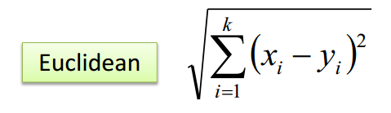
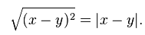
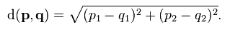
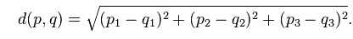
Distance

Slide 17
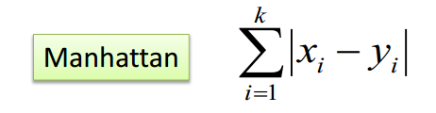
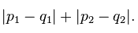
Distance

Slide 18
Major Clustering Approach
Partitioning approach
Construct various partitions and then evaluate them by some criterion
Typical methods:
k-means,
k-medoids,
Squared Error Clustering Algorithm
Nearest neighbor algorithm

Slide 19
Major Clustering Approach(Conti…)
Hierarchical approach
Hierarchical methods obtain a nested partition of the objects resulting in a tree of clusters.
Typical methods:
BIRCH(Balanced Iterative Reducing and Clustering Using Hierarchies),
ROCK(A Hierarchical Clustering Algorithm for Categorical Attributes).
Chameleon(A Hierarchical Clustering Algorithm Using Dynamic Modeling).

Slide 20
Major Clustering Approach(Conti…)
Density-based approach
Based on connectivity and density functions
Typical methods:
Density based methods include DBSCAN(A Density-Based Clustering Method on Connected Regions with Sufficiently High Density),
OPTICS( Ordering Points to Identify the Clustering Structure), DENCLUE(Clustering Based on Density Distribution Functions)

Slide 21
Major Clustering Approach(Conti…)
Grid-based approach
Based on a multiple-level granularity structure
Typical methods:
STING(Statistical Information Grid),
WaveCluster(Clustering Using Wavelet Transformation)
CLIQUE are some example of grid-based method.

Slide 22
Major Clustering Approach
Cluster Analysis
Partitions
Hierarchical Methods
Grid-Based
Model-Based
K-means
Agglomerative
Divisive
Density-Based
Expectation
Maximization

Slide 23
Clustering Algorithm(K-means)
K-means Algorithm: The K-means algorithm may be described as follows
Select the number of clusters. Let this number be K.
Pick K seeds as centroids of the k clusters. The seeds may be picked randomly unless the user has some insight into the data.
Compute the Euclidean distance of each object in the dataset from each of the centroids.
Allocate each object to the cluster it is nearest to base on the distances computer in the previous step.
Compute the centroids of the clusters by computing the means of the attribute values of the objects in each cluster.
Cheek if the stopping criterion has been met(e.g. the cluster membership is unchanged) if yes go to step 7. If not, go to step 3.
[optional] One may decide to stop at this stage or to split a cluster or combine two clusters heuristically until a stopping criterion is met.

Slide 24
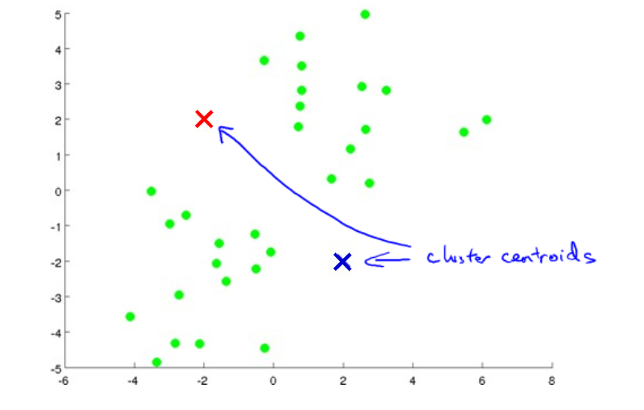
Clustering Algorithm(K-means)

Slide 25
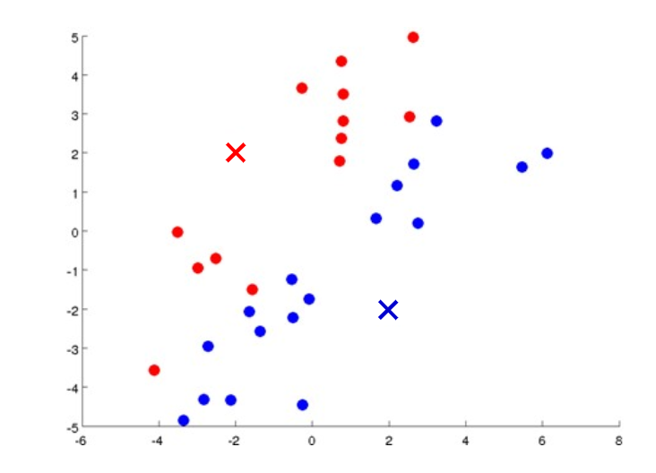
Clustering Algorithm(K-means)

Slide 26

Clustering Algorithm(K-means)

Slide 27
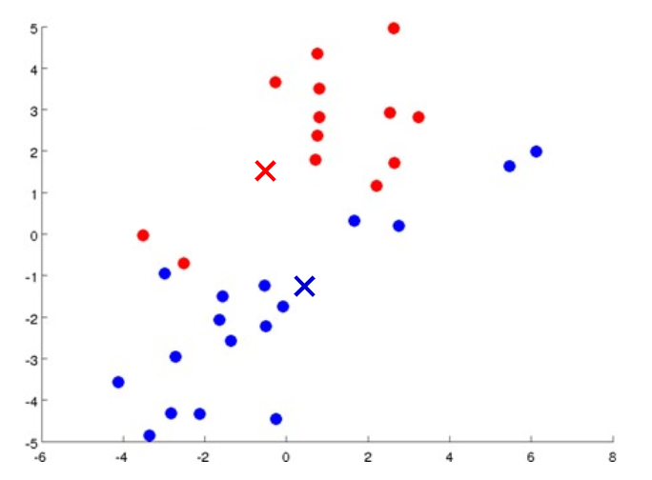
Clustering Algorithm(K-means)

Slide 28

Clustering Algorithm(K-means)

Slide 29

Clustering Algorithm(K-means)

Slide 30
k-Means
10
10
9
9
8
8
7
7
6
6
5
5
4
4
3
3
2
2
1
1
0
0
1
2
3
4
5
6
7
8
9
10
0
0
1
2
3
4
5
6
7
8
9
10
Step 4

Slide 31
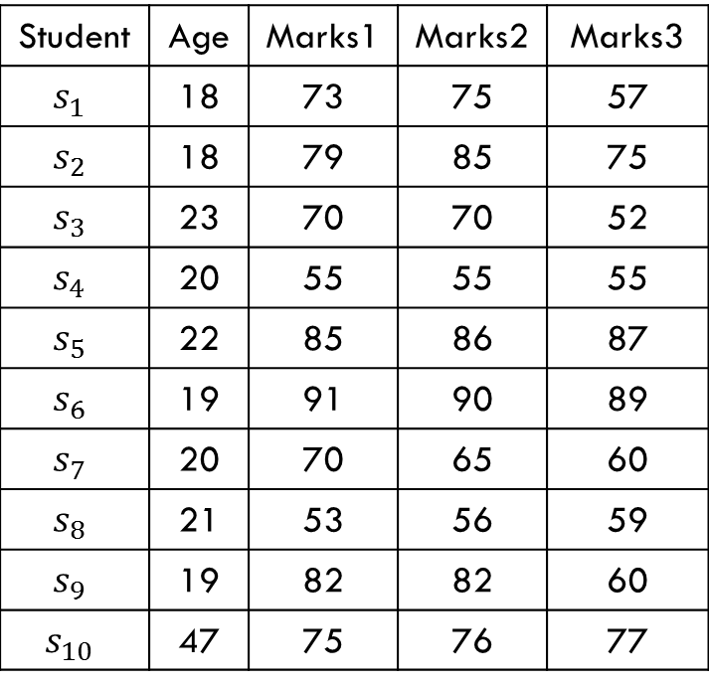
K-means Example
Consider the data about students. The only attributes are the age and the three marks
Table 1: Data For K-means clustering
Student | Age | Marks1 | Marks2 | Marks3
 | 18 | 73 | 75 | 57
 | 18 | 79 | 85 | 75
 | 23 | 70 | 70 | 52
 | 20 | 55 | 55 | 55
 | 22 | 85 | 86 | 87
 | 19 | 91 | 90 | 89
 | 20 | 70 | 65 | 60
 | 21 | 53 | 56 | 59
 | 19 | 82 | 82 | 60
 | 47 | 75 | 76 | 77

Slide 32
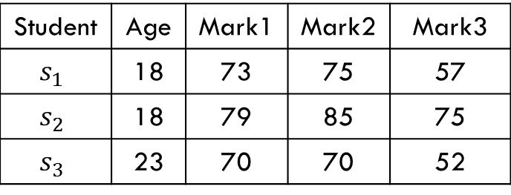
K-means Example(Conti…)
Steps 1 and 2: Let the three seeds be first three students.
Now compute the distances
Based on these distances, each student is allocated to the nearest cluster.
Table 2: The three seeds
Student | Age | Mark1 | Mark2 | Mark3
 | 18 | 73 | 75 | 57
 | 18 | 79 | 85 | 75
 | 23 | 70 | 70 | 52

Slide 33
K-means Example(Conti…)
C₁ | 18 | 73 | 75 | 57
S₁ | 18 | 73 | 75 | 57
 | 0 | 0 | 0 | 0
Total Distance |  |  | 0
C₁ | 18 | 73 | 75 | 57 | Distances from clusters |  |  | Allocation to the nearest cluster
C₂ | 18 | 79 | 85 | 75 | From | From | From
C₃ | 23 | 70 | 70 | 52 | C₁ | C₂ | C₃
S₁ | 18 | 73 | 75 | 57 | 0

Slide 34
K-means Example(Conti…)
C₂ | 18 | 79 | 85 | 75
S₁ | 18 | 73 | 75 | 57
 | 0 | 6 | 10 | 18
Total Distance |  |  | 34
C₁ | 18 | 73 | 75 | 57 | Distances from clusters |  |  | Allocation to the nearest cluster
C₂ | 18 | 79 | 85 | 75 | From | From | From
C₃ | 23 | 70 | 70 | 52 | C₁ | C₂ | C₃
S₁ | 18 | 73 | 75 | 57 | 0 | 34

Slide 35
K-means Example(Conti…)
C₃ | 23 | 70 | 70 | 52
S₁ | 18 | 73 | 75 | 57
 | 5 | 3 | 5 | 5
Total Distance |  |  | 18
C₁ | 18 | 73 | 75 | 57 | Distances from clusters |  |  | Allocation to the nearest cluster
C₂ | 18 | 79 | 85 | 75 | From | From | From
C₃ | 23 | 70 | 70 | 52 | C₁ | C₂ | C₃
S₁ | 18 | 73 | 75 | 57 | 0 | 34 | 18 | C₁

Slide 36
K-means Example(Conti…)
C₁ | 18 | 73 | 75 | 57
S₂ | 18 | 79 | 85 | 75
 | 0 | 6 | 10 | 18
Total Distance |  |  | 34
C₁ | 18 | 73 | 75 | 57 | Distances from clusters |  |  | Allocation to the nearest cluster
C₂ | 18 | 79 | 85 | 75 | From | From | From
C₃ | 23 | 70 | 70 | 52 | C₁ | C₂ | C₃
S₁ | 18 | 73 | 75 | 57 | 0 | 34 | 18 | C₁
S₂ | 18 | 79 | 85 | 75 | 34

Slide 37
K-means Example(Conti…)
C₂ | 18 | 79 | 85 | 75
S₂ | 18 | 79 | 85 | 75
 | 0 | 0 | 0 | 0
Total Distance |  |  | 0
C₁ | 18 | 73 | 75 | 57 | Distances from clusters |  |  | Allocation to the nearest cluster
C₂ | 18 | 79 | 85 | 75 | From | From | From
C₃ | 23 | 70 | 70 | 52 | C₁ | C₂ | C₃
S₁ | 18 | 73 | 75 | 57 | 0 | 34 | 18 | C₁
S₂ | 18 | 79 | 85 | 75 | 34 | 0

Slide 38
K-means Example(Conti…)
C₃ | 23 | 70 | 70 | 52
S₂ | 18 | 79 | 85 | 75
 | 5 | 9 | 15 | 23
Total Distance |  |  | 52
C₁ | 18 | 73 | 75 | 57 | Distances from clusters |  |  | Allocation to the nearest cluster
C₂ | 18 | 79 | 85 | 75 | From | From | From
C₃ | 23 | 70 | 70 | 52 | C₁ | C₂ | C₃
S₁ | 18 | 73 | 75 | 57 | 0 | 34 | 18 | C₁
S₂ | 18 | 79 | 85 | 75 | 34 | 0 | 52 | C₂

Slide 39
K-means Example(Conti…)
C₁ | 18 | 73 | 75 | 57 | Distances from clusters |  |  | Allocation to the nearest cluster
C₂ | 18 | 79 | 85 | 75 | From | From | From
C₃ | 23 | 70 | 70 | 52 | C₁ | C₂ | C₃
S₁ | 18 | 73 | 75 | 57 | 0 | 34 | 18 | C₁
S₂ | 18 | 79 | 85 | 75 | 34 | 0 | 52 | C₂
S₃ | 23 | 70 | 70 | 52 | 18 | 52 | 0 | C₃
S₄ | 20 | 55 | 55 | 55 | 42 | 76 | 36 | C₃
S₅ | 22 | 85 | 86 | 87 | 57 | 23 | 67 | C₂
S₆ | 19 | 91 | 90 | 89 | 66 | 32 | 82 | C₂
S₇ | 20 | 70 | 65 | 60 | 18 | 46 | 16 | C₃
S₈ | 21 | 53 | 56 | 59 | 44 | 74 | 40 | C₃
S₉ | 19 | 82 | 82 | 60 | 20 | 22 | 36 | C₁
S₁₀ | 47 | 75 | 76 | 77 | 52 | 44 | 60 | C₂

Slide 40
K-means Example(Conti…)
S₁ | 18 | 73 | 75 | 57
S₉ | 19 | 82 | 82 | 60
AVG | 18.5 | 77.5 | 78.5 | 58.5
 | Age | Marks1 | Marks2 | Marks3 | Cluster
S₁ | 18 | 73 | 75 | 57 | C₁
S₂ | 18 | 79 | 85 | 75 | C₂
S₃ | 23 | 70 | 70 | 52 | C₃
S₄ | 20 | 55 | 55 | 55 | C₃
S₅ | 22 | 85 | 86 | 87 | C₂
S₆ | 19 | 91 | 90 | 89 | C₂
S₇ | 20 | 70 | 65 | 60 | C₃
S₈ | 21 | 53 | 56 | 59 | C₃
S₉ | 19 | 82 | 82 | 60 | C₁
S₁₀ | 47 | 75 | 76 | 77 | C₂
 | Age | Mark1 | Mark2 | Mark3
C₁ | 18.5 | 77.5 | 78.5 | 58.5

Slide 41
K-means Example(Conti…)
S₂ | 18 | 79 | 85 | 75
S₅ | 22 | 85 | 86 | 87
S₆ | 19 | 91 | 90 | 89
S₁₀ | 47 | 75 | 76 | 77
AVG | 26.5 | 82.5 | 84.3 | 82.0
 | Age | Marks1 | Marks2 | Marks3 | Cluster
S₁ | 18 | 73 | 75 | 57 | C₁
S₂ | 18 | 79 | 85 | 75 | C₂
S₃ | 23 | 70 | 70 | 52 | C₃
S₄ | 20 | 55 | 55 | 55 | C₃
S₅ | 22 | 85 | 86 | 87 | C₂
S₆ | 19 | 91 | 90 | 89 | C₂
S₇ | 20 | 70 | 65 | 60 | C₃
S₈ | 21 | 53 | 56 | 59 | C₃
S₉ | 19 | 82 | 82 | 60 | C₁
S₁₀ | 47 | 75 | 76 | 77 | C₂
 | Age | Mark1 | Mark2 | Mark3
C₁ | 18.5 | 77.5 | 78.5 | 58.5
C₂ | 26.5 | 82.5 | 84.3 | 82.0

Slide 42
K-means Example(Conti…)
S₃ | 23 | 70 | 70 | 52
S₄ | 20 | 55 | 55 | 55
S₇ | 20 | 70 | 65 | 60
S₈ | 21 | 53 | 56 | 59
AVG | 21 | 61.5 | 61.5 | 56.5
 | Age | Marks1 | Marks2 | Marks3 | Cluster
S₁ | 18 | 73 | 75 | 57 | C₁
S₂ | 18 | 79 | 85 | 75 | C₂
S₃ | 23 | 70 | 70 | 52 | C₃
S₄ | 20 | 55 | 55 | 55 | C₃
S₅ | 22 | 85 | 86 | 87 | C₂
S₆ | 19 | 91 | 90 | 89 | C₂
S₇ | 20 | 70 | 65 | 60 | C₃
S₈ | 21 | 53 | 56 | 59 | C₃
S₉ | 19 | 82 | 82 | 60 | C₁
S₁₀ | 47 | 75 | 76 | 77 | C₂
 | Age | Mark1 | Mark2 | Mark3
C₁ | 18.5 | 77.5 | 78.5 | 58.5
C₂ | 26.5 | 82.5 | 84.3 | 82.0
C₃ | 21 | 61.5 | 61.5 | 56.5

Slide 43
K-means Example(Conti…)
 | Age | Marks1 | Marks2 | Marks3 | Cluster
S₁ | 18 | 73 | 75 | 57 | C₁
S₂ | 18 | 79 | 85 | 75 | C₂
S₃ | 23 | 70 | 70 | 52 | C₃
S₄ | 20 | 55 | 55 | 55 | C₃
S₅ | 22 | 85 | 86 | 87 | C₂
S₆ | 19 | 91 | 90 | 89 | C₂
S₇ | 20 | 70 | 65 | 60 | C₃
S₈ | 21 | 53 | 56 | 59 | C₃
S₉ | 19 | 82 | 82 | 60 | C₁
S₁₀ | 47 | 75 | 76 | 77 | C₂
 | Age | Mark1 | Mark2 | Mark3
C₁ | 18.5 | 77.5 | 78.5 | 58.5
C₂ | 26.5 | 82.5 | 84.3 | 82.0
C₃ | 21 | 61.5 | 61.5 | 56.5
Cluster membership
Cluster-1: S₁ , S₉
Cluster-2: S₂ ,S₅ , S₆ , S₁₀
Cluster-3: S₃ , S₄ S₇ S₈

Slide 44
K-means Example(Conti…)
Use the new cluster means to re compute the distance of each object to each of the means, again allocating each object to the nearest cluster.

Slide 45
K-means Example(Conti…)
C₁ | 18.5 | 77.5 | 78.5 | 58.5 | Distances from clusters |  |  | Allocation to the nearest cluster
C₂ | 26.5 | 82.5 | 84.3 | 82 | From | From | From
C₃ | 21.0 | 62.0 | 61.5 | 56.5 | C₁ | C₂ | C₃
S₁ | 18 | 73 | 75 | 57 | 10.0 | 52.3 | 28.0 | C₁
S₂ | 18 | 79 | 85 | 75 | 25.0 | 19.8 | 62.0 | C₂
S₃ | 23 | 70 | 70 | 52 | 27.0 | 60.3 | 23.0 | C₃
S₄ | 20 | 55 | 55 | 55 | 51.0 | 90.3 | 16.0 | C₃
S₅ | 22 | 85 | 86 | 87 | 47.0 | 13.8 | 79.0 | C₂
S₆ | 19 | 91 | 90 | 89 | 56.0 | 28.8 | 92.0 | C₂
S₇ | 20 | 70 | 65 | 60 | 24.0 | 60.3 | 16.0 | C₃
S₈ | 21 | 53 | 56 | 59 | 50.0 | 86.3 | 17.0 | C₃
S₉ | 19 | 82 | 82 | 60 | 10.0 | 32.3 | 46.0 | C₁
S₁₀ | 47 | 75 | 76 | 77 | 52.0 | 41.3 | 74.0 | C₂

Slide 46
K-means Example(Conti…)
No changes in member
We have done.
Cluster membership
Cluster-1: S₁ , S₉
Cluster-2: S₂ ,S₅ , S₆ , S₁₀
Cluster-3: S₃ , S₄ S₇ S₈

Slide 47
Illustration of k-Means clustering algorithms
A₁ | A₂
6.8 | 12.6
0.8 | 9.8
1.2 | 11.6
2.8 | 9.6
3.8 | 9.9
4.4 | 6.5
4.8 | 1.1
6.0 | 19.9
6.2 | 18.5
7.6 | 17.4
7.8 | 12.2
6.6 | 7.7
8.2 | 4.5
8.4 | 6.9
9.0 | 3.4
9.6 | 11.1
Plotting data of Table 16.1

Slide 48
Illustration of k-Means clustering algorithms
Suppose, k=3. Three objects are chosen at random shown as circled . These three centroids are shown below.
Initial Centroids chosen randomly
Let us consider the Euclidean distance measure (L₂ Norm) as the distance measurement in our illustration.
Let d₁, d₂ and d₃ denote the distance from an object to c₁, c₂ and c₃ respectively.
Centroid |  | Objects
 | A1 |  | A2
c₁ | 3.8 |  | 9.9
c₂ | 7.8 |  | 12.2
c₃ | 6.2 |  | 18.5

Slide 49
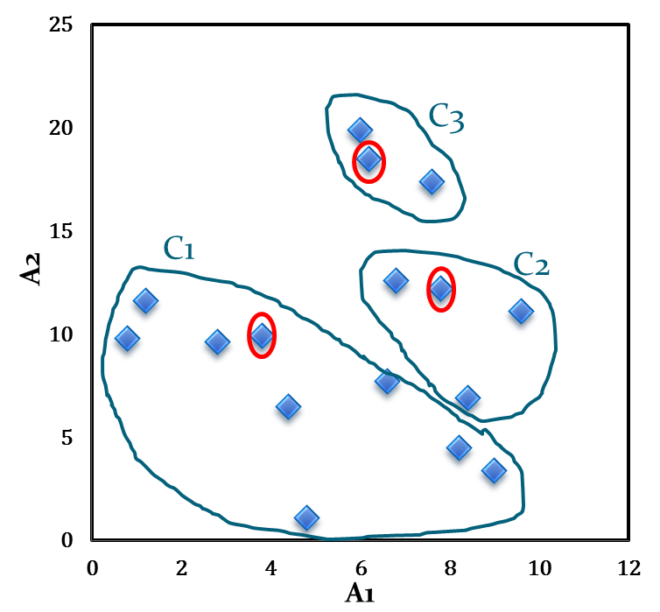
Illustration of k-Means clustering algorithms
A₁ | A₂ | d₁ | d₂ | d₃ | _{cluster}
6.8 | 12.6 | 4.0 | 1.1 | 5.9 | 2
0.8 | 9.8 | 3.0 | 7.4 | 10.2 | 1
1.2 | 11.6 | 3.1 | 6.6 | 8.5 | 1
2.8 | 9.6 | 1.0 | 5.6 | 9.5 | 1
3.8 | 9.9 | 0.0 | 4.6 | 8.9 | 1
4.4 | 6.5 | 3.5 | 6.6 | 12.1 | 1
4.8 | 1.1 | 8.9 | 11.5 | 17.5 | 1
6.0 | 19.9 | 10.2 | 7.9 | 1.4 | 3
6.2 | 18.5 | 8.9 | 6.5 | 0.0 | 3
7.6 | 17.4 | 8.4 | 5.2 | 1.8 | 3
7.8 | 12.2 | 4.6 | 0.0 | 6.5 | 2
6.6 | 7.7 | 3.6 | 4.7 | 10.8 | 1
8.2 | 4.5 | 7.0 | 7.7 | 14.1 | 1
8.4 | 6.9 | 5.5 | 5.3 | 11.8 | 2
9.0 | 3.4 | 8.3 | 8.9 | 15.4 | 1
9.6 | 11.1 | 5.9 | 2.1 | 8.1 | 2
Distance calculation

Slide 50
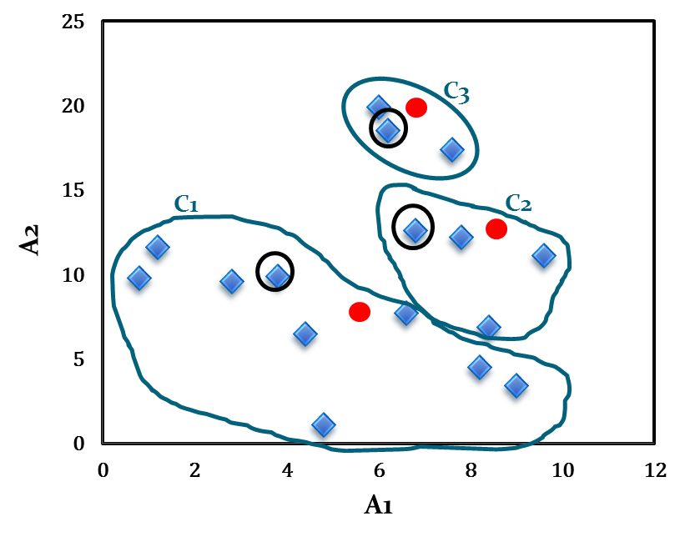
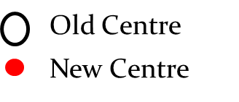
Illustration of k-Means clustering algorithms
The calculation new centroids of the three cluster using the mean of attribute values of A₁ and A₂ is shown in the Table below.
New Centroid |  | Objects
 | A1 |  | A2
c₁ | 4.6 |  | 7.1
c₂ | 8.2 |  | 10.7
c₃ | 6.6 |  | 18.6
Calculation of new centroids

Slide 51
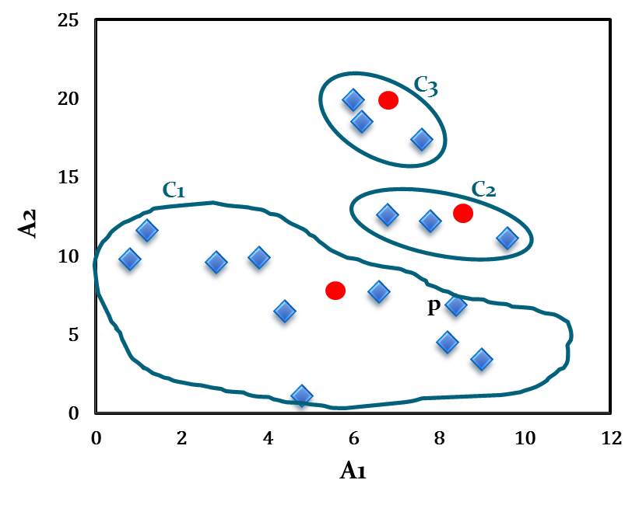
Illustration of k-Means clustering algorithms
Note that point p moves from cluster C₂ to cluster C₁.

Slide 52
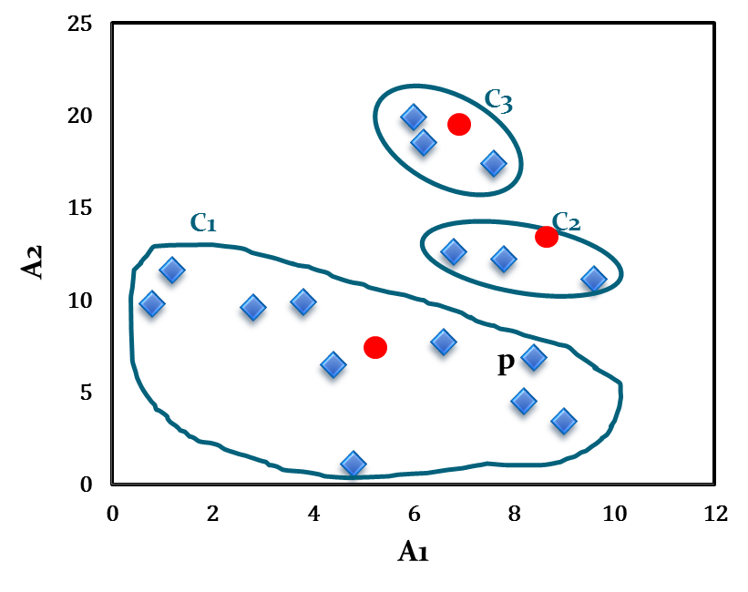
Illustration of k-Means clustering algorithms
The newly obtained centroids after second iteration are given in the table below
With respect to newly obtained cluster centres, 16 points are reassigned again. These are the same clusters as before. Hence, their centroids also remain unchanged.
Cluster centres after second iteration
Centroid | Revised Centroids
 | A1 | A2
c₁ | 5.0 | 7.1
c₂ | 8.1 | 12.0
c₃ | 6.6 | 18.6

Slide 53
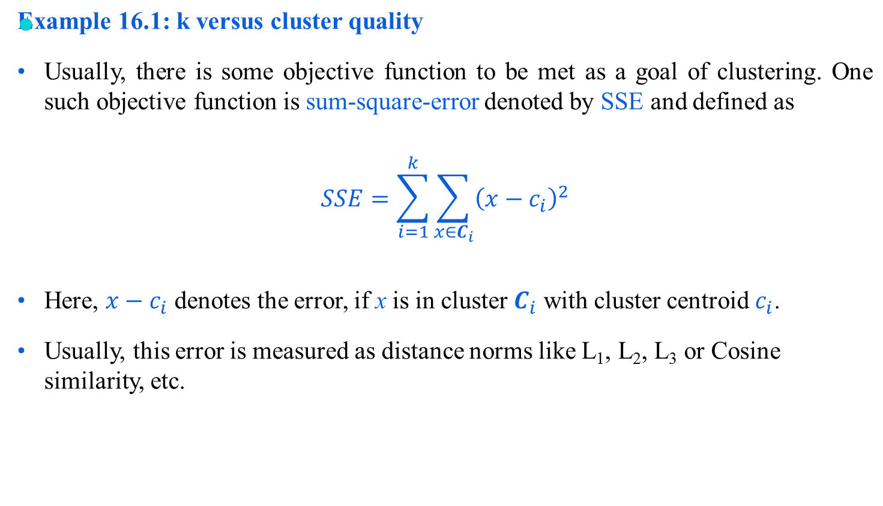
k versus cluster quality

Slide 54
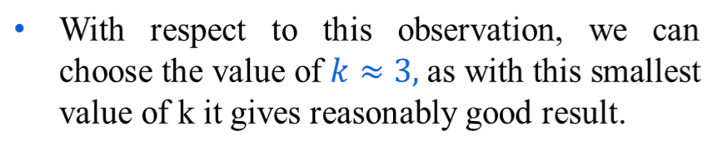
k versus cluster quality
k | SSE
1 | 62.8
2 | 12.3
3 | 9.4
4 | 9.3
5 | 9.2
6 | 9.1
7 | 9.05
8 | 9.0

Slide 55
Strengths of k-means
Strengths:
Simple: easy to understand and to implement
Efficient: Time complexity: O(tkn),
where n is the number of data points,
k is the number of clusters, and
t is the number of iterations.
Since both k and t are small. k-means is considered a linear algorithm.
K-means is the most popular clustering algorithm.

Slide 56
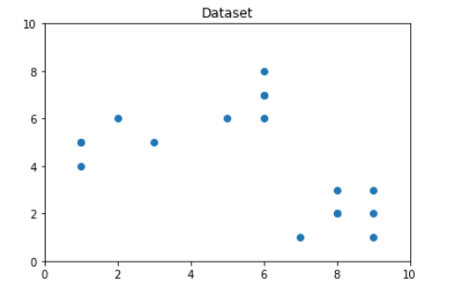
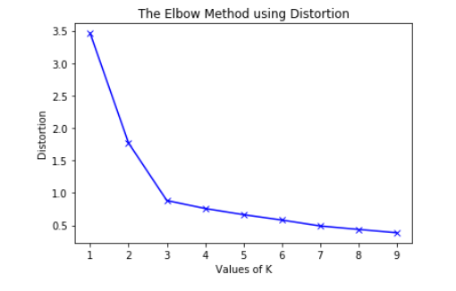
Elbow Method for optimal value of k in K-Means
Distortion: It is calculated as the average of the squared distances from the cluster centers of the respective clusters.

Slide 57
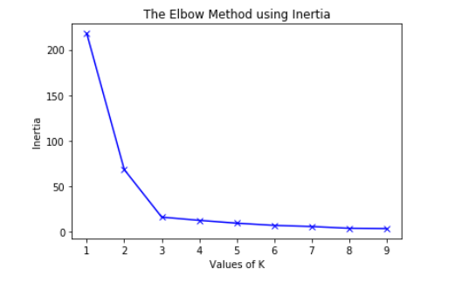
Elbow Method for optimal value of k in K-Means
Inertia: It is the sum of squared distances of samples to their closest cluster center.

Slide 58
Weaknesses of k-means
The algorithm is sensitive to outliers and noisy data
Outliers are data points that are very far away from other data points.
Outliers could be errors in the data recording or some special data points with very different values.

Slide 59
Nearest Neighbor Algorithm
An algorithm similar to the single link technique is called the nearest neighbor algorithm.
With this serial algorithm, items are iteratively merged into the existing clusters that are closet.
In this algorithm a threshold, t is used to determine if items will be added to existing clusters or if a new cluster is created.

Slide 60
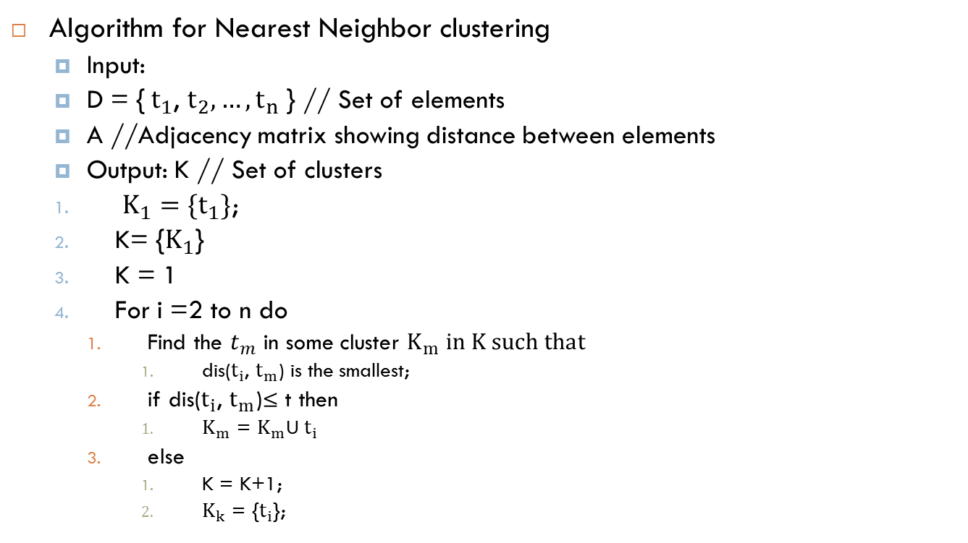
Nearest Neighbor Algorithm
Algorithm for Nearest Neighbor clustering
Input:
D = {${ t}_{1}$,$t_{2},…,t_{n}$ } // Set of elements
A //Adjacency matrix showing distance between elements
Output: K // Set of clusters
$K_{1}=\{t_{1}\}$;
K= {$K_{1}$}
K = 1
For i =2 to n do
Find the $t_{m}$ in some cluster $K_{m} in K such that$
dis($t_{i}$,$t_{m}$) is the smallest;
if dis($t_{i}$, $t_{m}$)≤ t then
$K_{m}$ = $K_{m}$U $t_{i}$
else
K = K+1;
$K_{k}$ = {$t_{i}$};

Slide 61
Nearest Neighbor Algorithm Example
Table : Distance among A, B, C, D, E data
Item | A | B | C | D | E
A | 0 | 1 | 2 | 2 | 3
B | 1 | 0 | 2 | 4 | 3
C | 2 | 2 | 0 | 1 | 5
D | 2 | 4 | 1 | 0 | 3
E | 3 | 3 | 5 | 3 | 0

Slide 62
Nearest Neighbor Algorithm Example
A placed to a cluster by itself
K1={A}
Item | A | B | C | D | E
A | 0 | 1 | 2 | 2 | 3
B | 1 | 0 | 2 | 4 | 3
C | 2 | 2 | 0 | 1 | 5
D | 2 | 4 | 1 | 0 | 3
E | 3 | 3 | 5 | 3 | 0

Slide 63
Nearest Neighbor Algorithm Example
Consider B, should it be added to K1 or form a new cluster?
Dist(A,B)=1 and less than threshold value 2
So K1={A, B}
Item | A | B | C | D | E
A | 0 | 1 | 2 | 2 | 3
B | 1 | 0 | 2 | 4 | 3
C | 2 | 2 | 0 | 1 | 5
D | 2 | 4 | 1 | 0 | 3
E | 3 | 3 | 5 | 3 | 0

Slide 64
Nearest Neighbor Algorithm Example
For C we calculate distance from both A and B.
Dist(AB, C)= min{dist(A, C), Dist(B, C)}
Dist(AB, C)=2
So K1={A, B, C}
Item | A | B | C | D | E
A | 0 | 1 | 2 | 2 | 3
B | 1 | 0 | 2 | 4 | 3
C | 2 | 2 | 0 | 1 | 5
D | 2 | 4 | 1 | 0 | 3
E | 3 | 3 | 5 | 3 | 0

Slide 65
Nearest Neighbor Algorithm Example
Dist(ABC, D)= min{Dist(A, D), Dist(B, D),Dist(C, D)}
=min{2,4,1}
=1
So K1={A, B, C, D}
Item | A | B | C | D | E
A | 0 | 1 | 2 | 2 | 3
B | 1 | 0 | 2 | 4 | 3
C | 2 | 2 | 0 | 1 | 5
D | 2 | 4 | 1 | 0 | 3
E | 3 | 3 | 5 | 3 | 0

Slide 66
Nearest Neighbor Algorithm Example
Dist(ABCD, E)= min{Dist(A, E), Dist(B, E),Dist(C, E), Dist(C, E)}
=min{3, 3, 5, 3}
=3 greater than threshold value.
So K1={A, B, C, D}
And K2={E}
Item | A | B | C | D | E
A | 0 | 1 | 2 | 2 | 3
B | 1 | 0 | 2 | 4 | 3
C | 2 | 2 | 0 | 1 | 5
D | 2 | 4 | 1 | 0 | 3
E | 3 | 3 | 5 | 3 | 0

Slide 67
Thank you

